Slide 1

CHITKARA UNIVERSITY INSTITUTE OF ENGINEERING & TECHNOLOGY
Department of Computer Science & Engineering
Minor Project Presentation
Project Title: Artist Website(Zayn)
Group Name- Team_G9_12
Presented by:
1. SHIVAM SAINI (2010990664)
2. SUBHANSHU BISHT (2010990704)

Slide 2
Contents
Abstract
Introduction
Problem Statement
Proposed Solution
Technology Used
Key Features
Project Snapshots
Conclusions
References

Slide 3
Abstract / Introduction
Artistic Website which is helpful for the artist fans to engage with their favorite artist art such as their music , merch, photoshoots , videos . In this website made by both of us brings you to the world of Zayn and his beautiful art. We both build these website in a span of 15 days . We had more plans but due to the deadline we only focused on music and merch section more. This website is mostly based on media content and design elements . Also have some cool things to explore in.

Slide 4
Problem Statement
Lots of fans face problem finding artist genuine music or art and supporting the artist, and
They also stream music from an unofficial website which cause a loss to the artist and also
Buy fake/copied merch from different website is also a loss and a damage to artists art.

Slide 5
Problem Proposed
You can stream artist music .
You can Buy artist merch.
You can get to know more about the artist.
You can support the artist.

Slide 6
Technology Used
HTML – To provide and give structure to the website.
CSS – To design the website elements.
JavaScript – To create animations and music player and merch page.
Google Fonts – It is used to get fonts

Slide 7
Key Feature
1. Our Design
2. UI of Music player
3. Whole website design elements.
4.Shopping Cart.

Slide 8
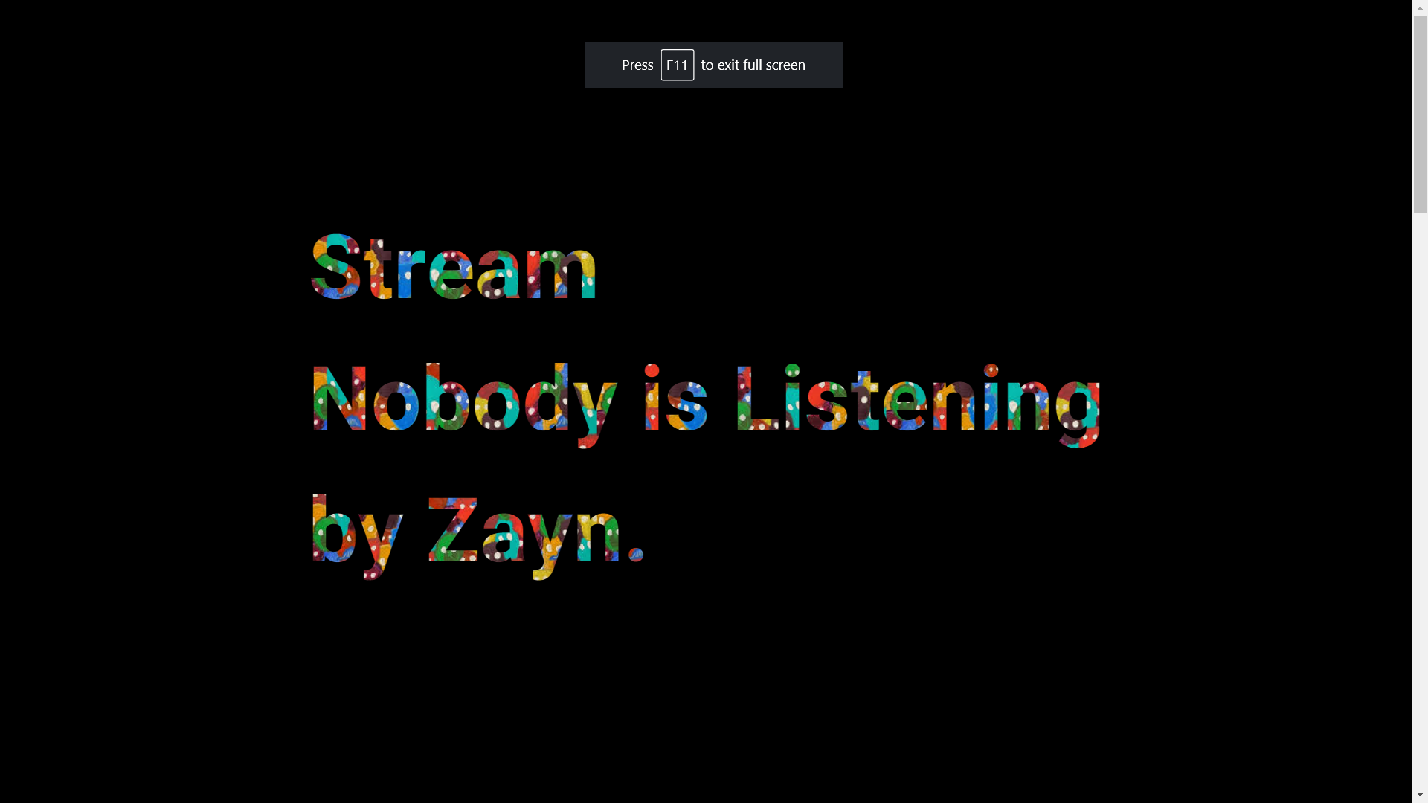
Project Snapshots

Slide 9
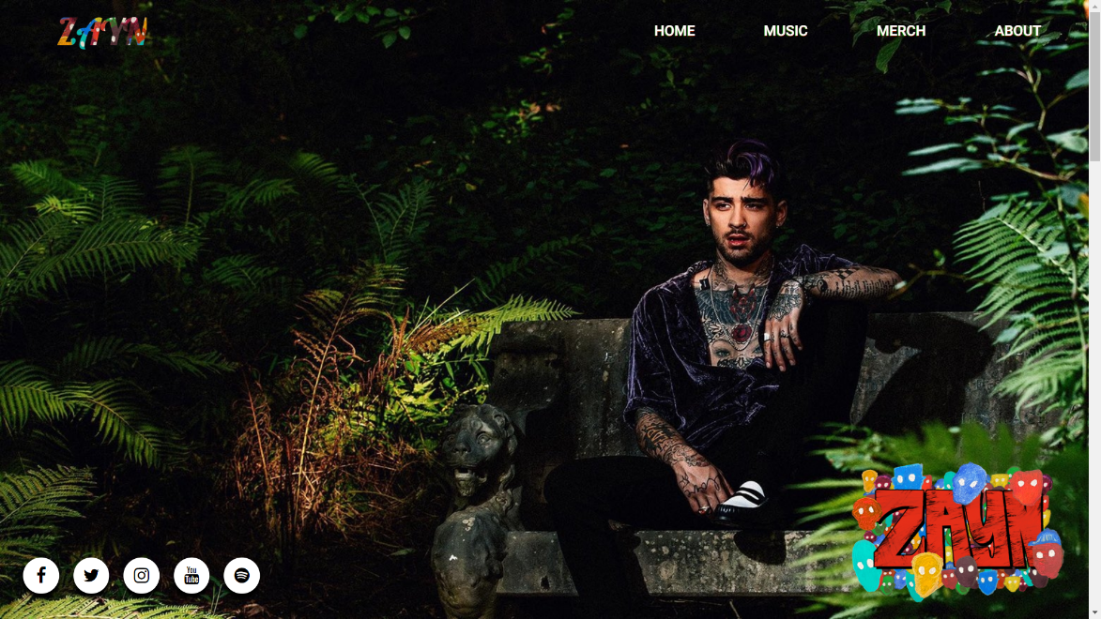
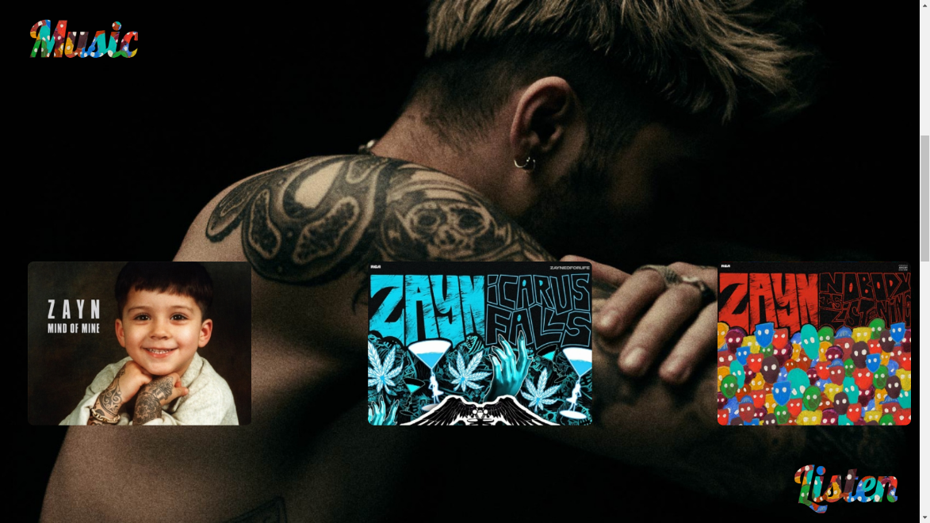
Project Snapshots

Slide 10
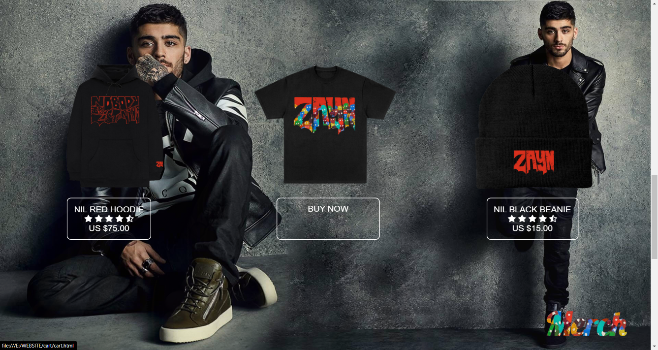
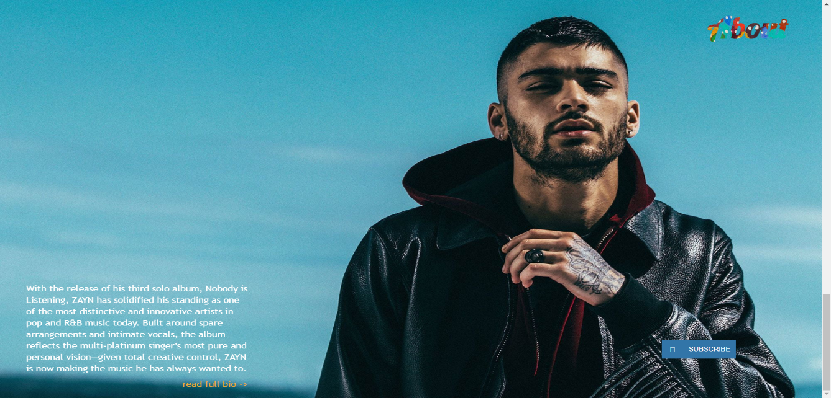
Project Snapshots

Slide 11
Conclusion
In Conclusion , We made this website just for learning things and representing our love for our favorite artist i.e. Zayn Malik . If we had more time we would have represented it more well and must have added
A lot of functionality as compared to now.

Slide 12
References
youtube.com
inzayn.in
rcarecords.com
zaynmalikweb.com(For media).

Slide 13
THANK YOU

